Slide 1

Comparative analysis of machine learning methods for analyzing security practice in electronic health records’ logs.
By: Prosper K. Yeng, Muhammad A. Fauzi, Bian Yang:
Norwegian University of Science and Technology

Slide 2
Outline
Motivation
Background
Objective/Research Question
Discussion
Results

Slide 3
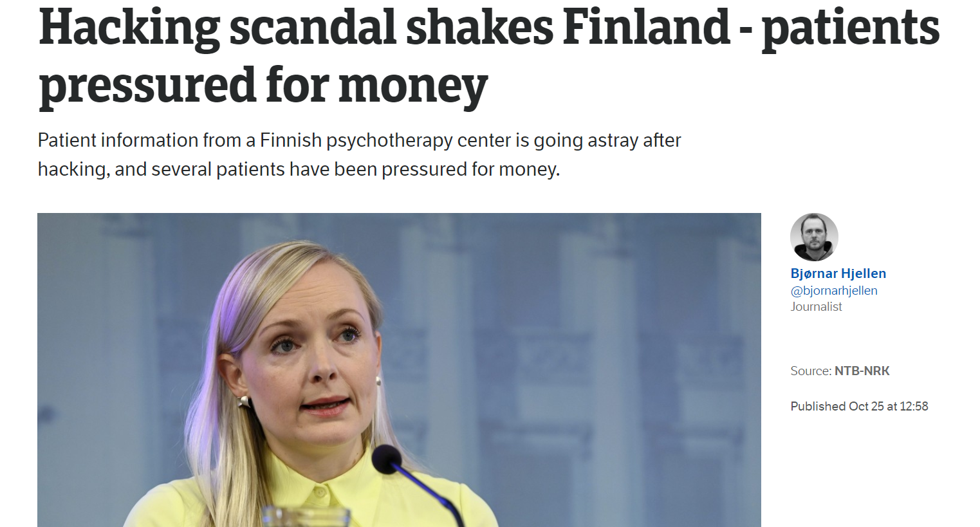

Slide 4
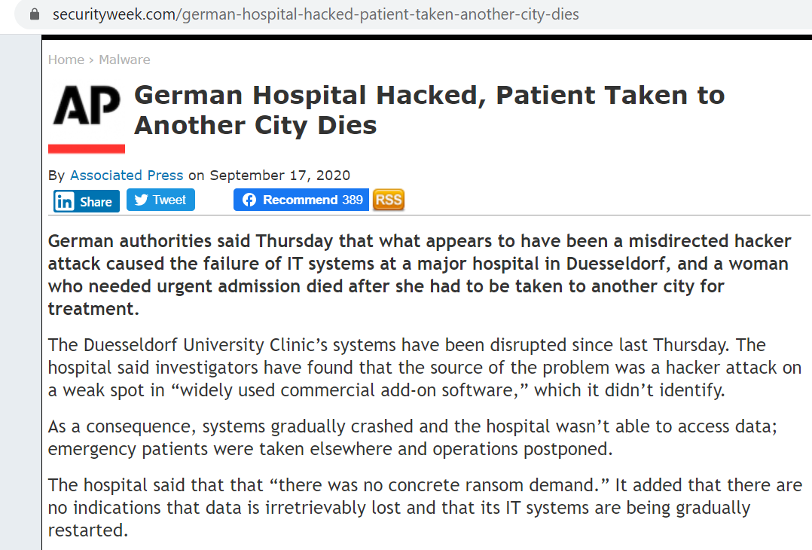

Slide 5
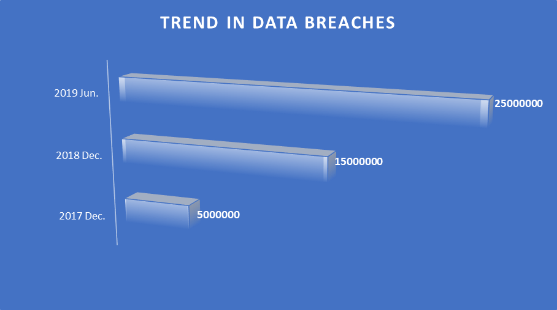

Slide 6
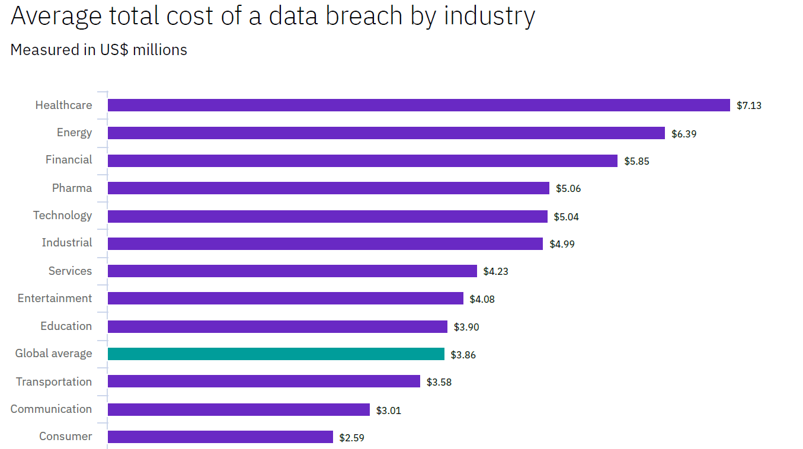

Slide 7
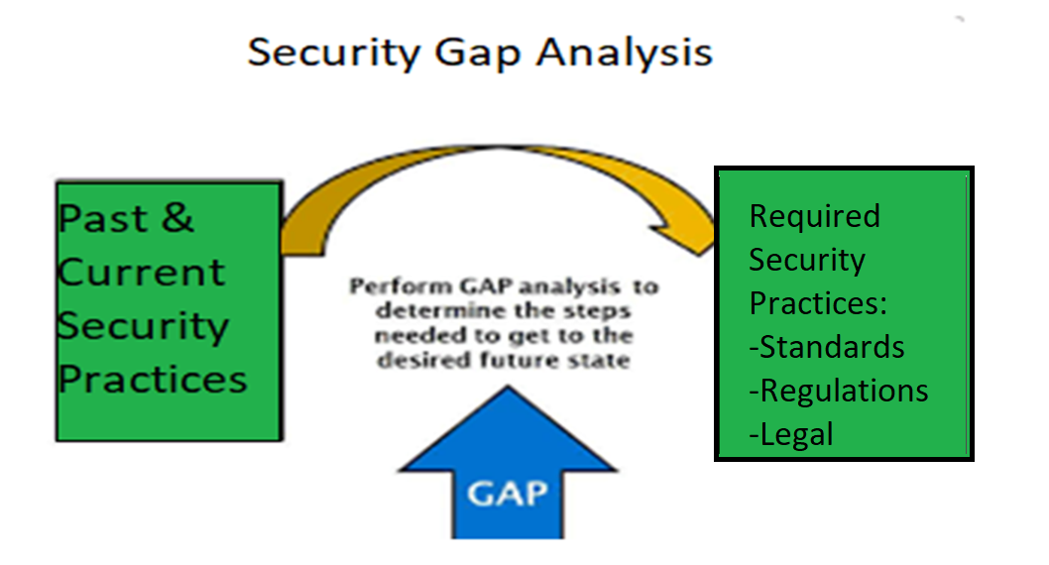
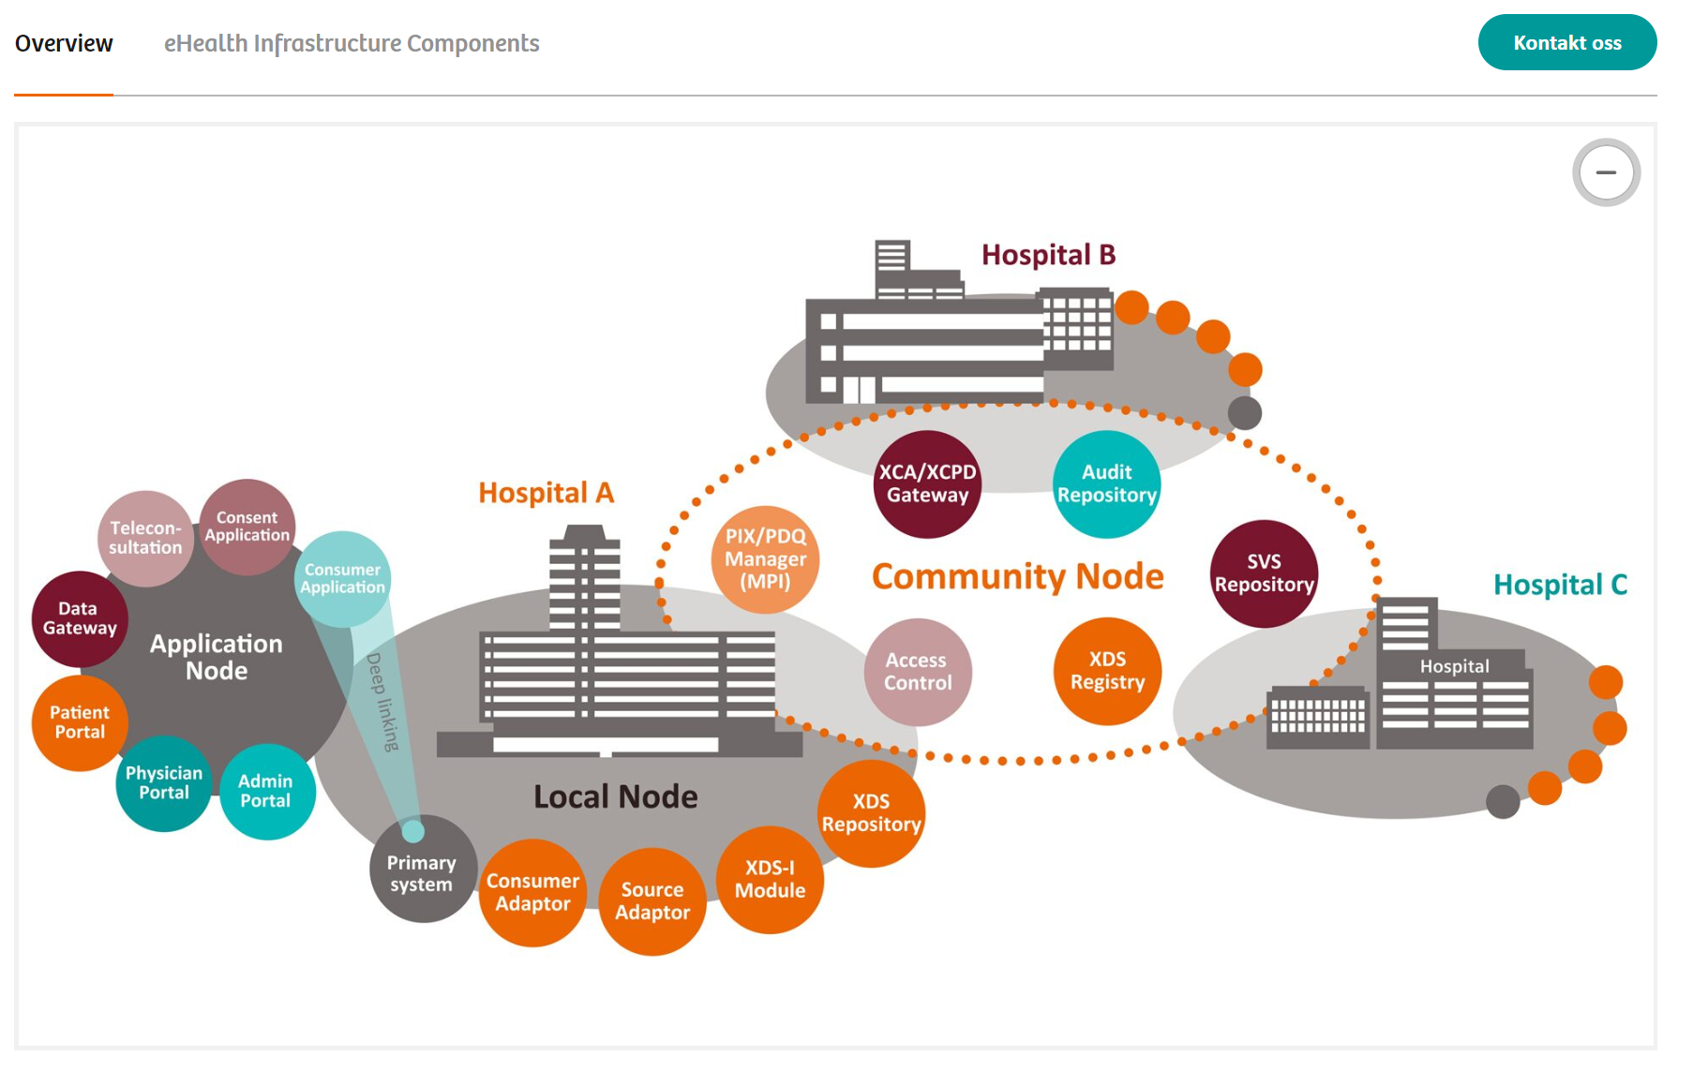
What is the goal and Why?
Firewalls
DMZs
IDS/IPS
Antivirus
Other Technologies
More attention on tech. measures than the human firewall!

Slide 8
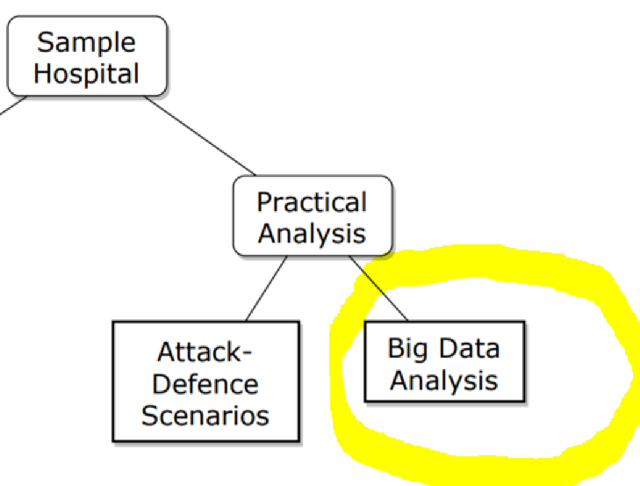
What is the objective of this paper?
To compare machine learning classification methods towards anaysing healthcare security practice.

Slide 9
What is healthcare security practice?
Healthcare:
Big data context:
Behaviors required to put up by healthcare staff in order to comply with CIA requirements of information systems
Traces of users’ electronic accesses (logs) which can be reconstructed to form individuals unique access profiles

Slide 10
What is the Scope Research Question and contribution?
Amid various machine learning methods, which of the methods is suitable for analysing healthcare security practice in EHR logs?

Slide 11
Method: Data simulation (Normal data)

Slide 12

Security requirement in EHR
Case study: Norway

Slide 13
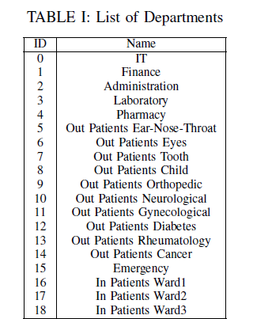

Slide 14
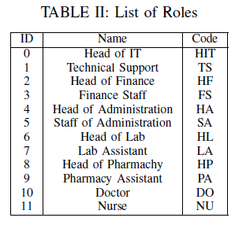

Slide 15
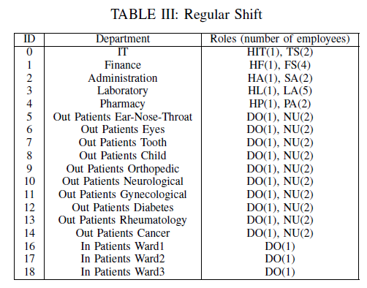
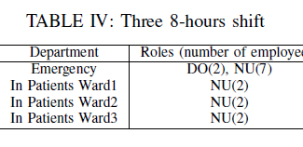

Slide 16
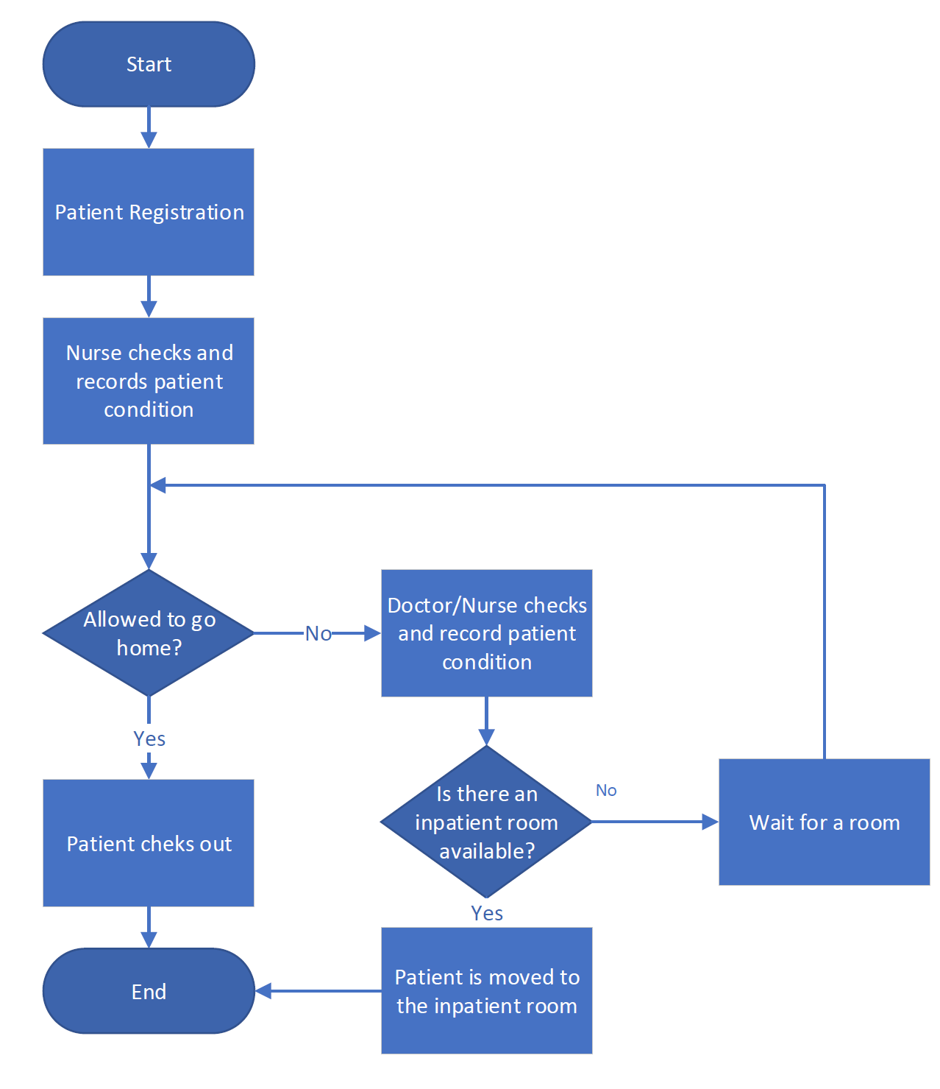
Inpatient flow

Slide 17
EHR rules by the healthcae code of conduct in Norway:
Accessing patients records is only allowed for therapeutic purposes
Access is given to only those with an official need to use,
Self-authorization or ”break the glass” scenarios is allowed but the necessary measures should be provided,
All of the activities related to access of the personal health data (register, update, edit, delete etc )must be logged

Slide 18
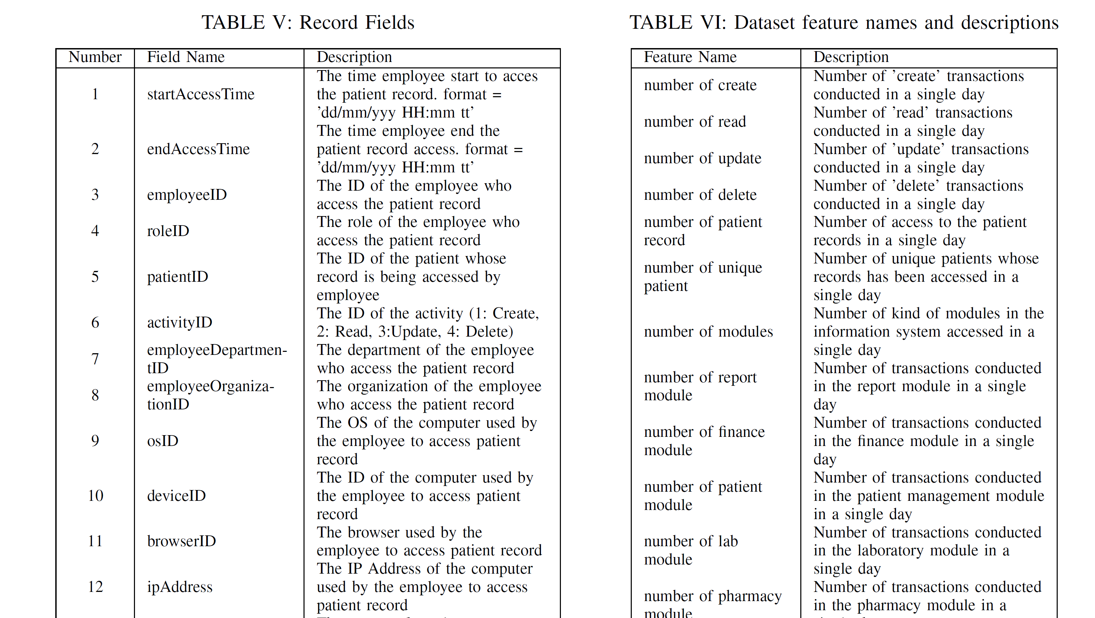
Attributes and features

Slide 19

Abnormal data simulation
Access by identity theft.
The attacker will access more data than legitimate users
Attackers sometimes not follow the flows.

Slide 20
Data Processing cont...
From this data simulation,
283,678 logs were created
Legitimate access were 274,983
Fraudulent access were 8,695

Slide 21
Data Processing cont...
we process the logs data into 24-hour blocks so that an instance represents the
cumulative activity of a user in a single day.
24,286 of them are considered normal
362 of them are considered an anormal

Slide 22
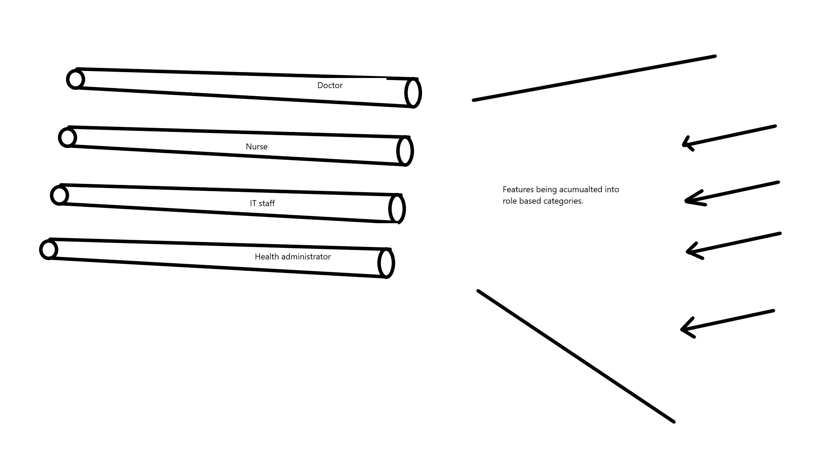
Role classification model
classify the cumulative user activity in a single day into one of the 12 categories
The model was used to classify the cumulative activity of a user in a single
Day
The model was then trained and validated with cross-fold validation

Slide 23
Anomaly Detection
Hard classification
Soft classification
we classify each instance into one category (role)
If an instance is classified into their actual role, then the instance is considered normal.
If the instance was misclassified, then that instance was considered abnormal practice
It gives tolerance for the user to act like users from other roles because some roles have quite similar activities.
The classifier compute the probability of the user’s instance belong to their role class.
If the probability is above a particular threshold, then it is considered normal.
Otherwise, it will be considered an anomaly

Slide 24
Algorithms compared
Multinomial Naive Bayes(multnb),
Bernoulli Naive Bayes (bernnb),
Support Vector Machine (svm),
Neural Network (nn),
K-Nearest Neighbours(knn),
Logistic Regression (lr),
Random Forest (rf),
Decision Tree (dt).

Slide 25
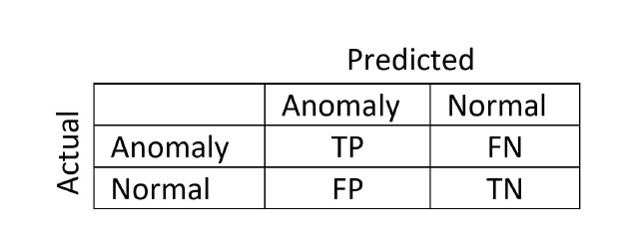
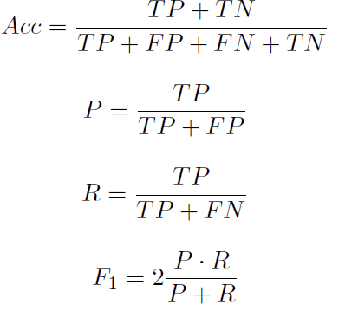
Performance measures
Precision, p: Number of instances that are labeled as anormaly,how many are actually anomaly?
Recall, R: Number of all instances that are actually anomaly, how many of those are correctly predicted
F1 Mesure: is the harmonic mean(average) of the precision and recall

Slide 26
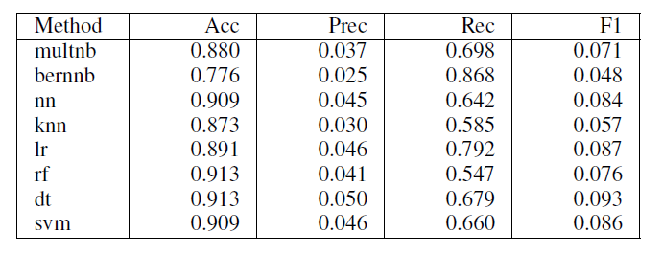
Findings
Hard classification None normalized

Slide 27
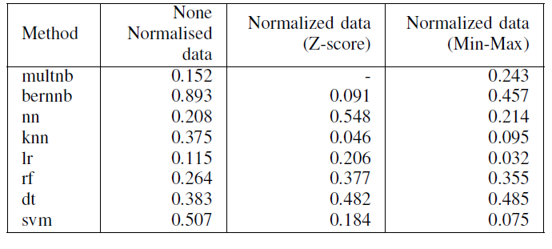
Soft classification (F1- score)

Slide 28
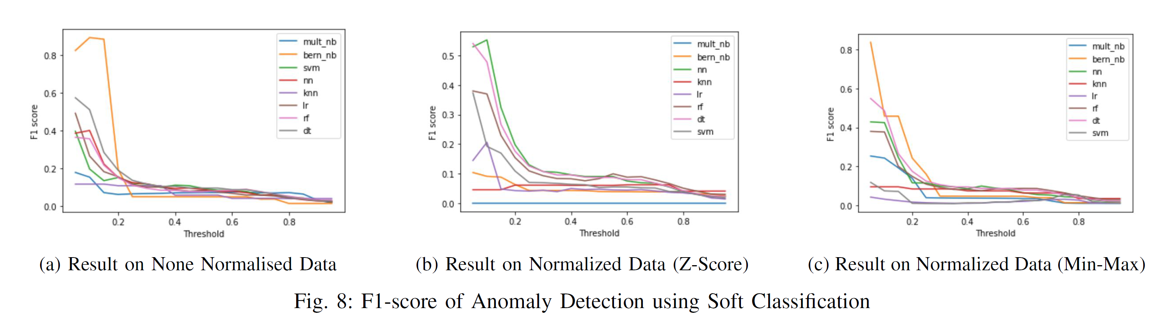
Soft classification (F1- score)…

Slide 29
Performance
Generally, the Soft Classification approach achieved better performance than the Hard Classification approach
Bernoulli Naive Bayes on the None Normalised data performed better with an F1-score of 0.893.

Slide 30
All of the methods obtained a high recall and accuracy but low precision and F1-score.
This high recall means that the method from this work can be a good tool to narrow down the data for further manual investigation.
Soft Classification approach performed better than the Hard Classification approach because it provides some tolerances as roles in different activities can be very similar.

Slide 31
Future works
future works on further processing the anomalies to detect malicious activities.
Additional, as labeled real data can be difficult to get, it is also important to compare unsupervised methods for the detection of anomalies and maliciousness in the context of big data.

Slide 32

Thank You For Your Attention!
Questions?
PROSPER K. YENG
PhD. Candidate
Norwegian University of Science and Technology
E-mail: Prosper.Yeng@ntnu.no

